Slide 1
Parallel Evolutionary Algorithm in Scheduling Work Packages to Minimize the Duration of Software Project
Jinghui Hu, Xu Wang, Jian Ren, Chao Liu
School of Computer Science and Engineering
Beihang University
NASAC2017@Harbin

Slide 2
Motivations
Software Project Management
1. resources allocation
2. work package scheduling
GPGPU Acceleration
How to accelerate computing by parallelism?
Objective
To find minimal overall duration of a software project
by optimizing Work Package Sequence (WPS),
while satisfying work package dependencies and
resources constraint.

Slide 3
Outline
Background & Problem Definition
Evolutionary Algorithm
Parallelism using GPGPU
Research Questions & Results
Tool & Future Work

Slide 4
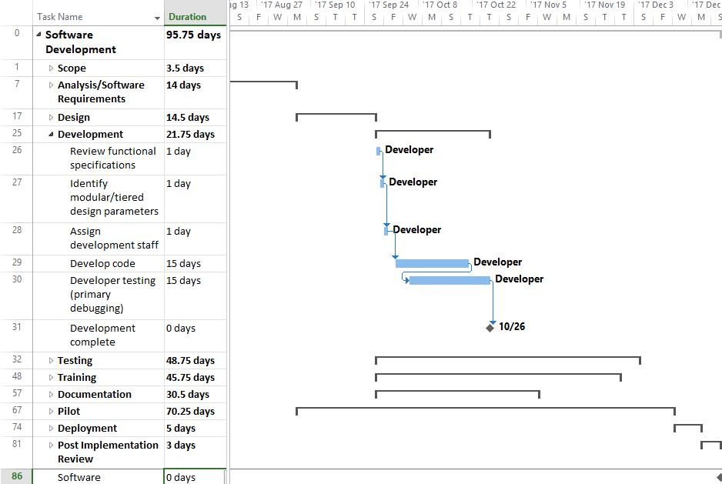
How PM mange a project in Microsoft Project
resources
dependencies
work packages

Slide 5
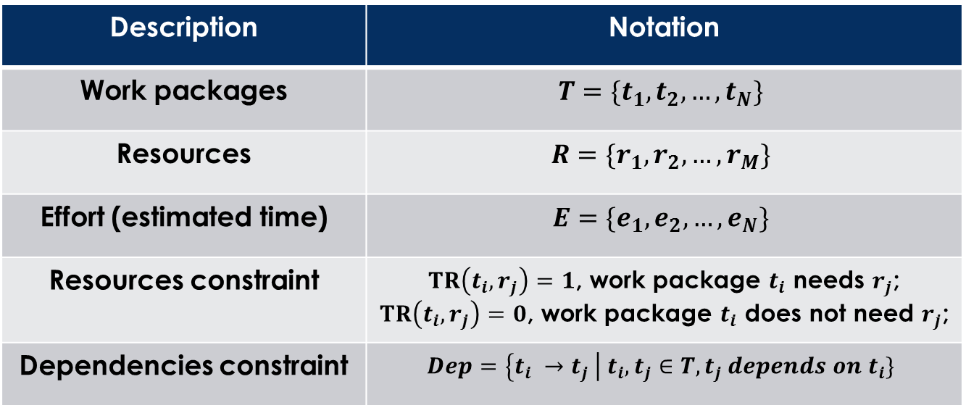
Problem Definition
Description | Notation
Work packages | $$T=\{t_{1}, t_{2}, …, t_{N}\}$$
Resources | $$R=\{r_{1}, r_{2}, …, r_{M}\}$$
Effort (estimated time) | $$E=\{e_{1}, e_{2},…, e_{N}\}$$
Resources constraint | $TR\left(t_{i}, r_{j}\right)=1$, work package $t_{i}$ needs $r_{j}$; $TR\left(t_{i}, r_{j}\right)=0$, work package $t_{i}$ does not need $r_{j}$;
Dependencies constraint | $$Dep=\left\{t_{i} →t_{j} \right| t_{i}, t_{j}∈T, t_{j} depends on t_{i}\}$$

Slide 6

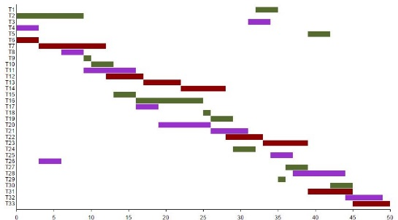
The Objective of Optimization
Find an optimal work package sequence:
The Objective is to minimize overall duration:

Slide 7
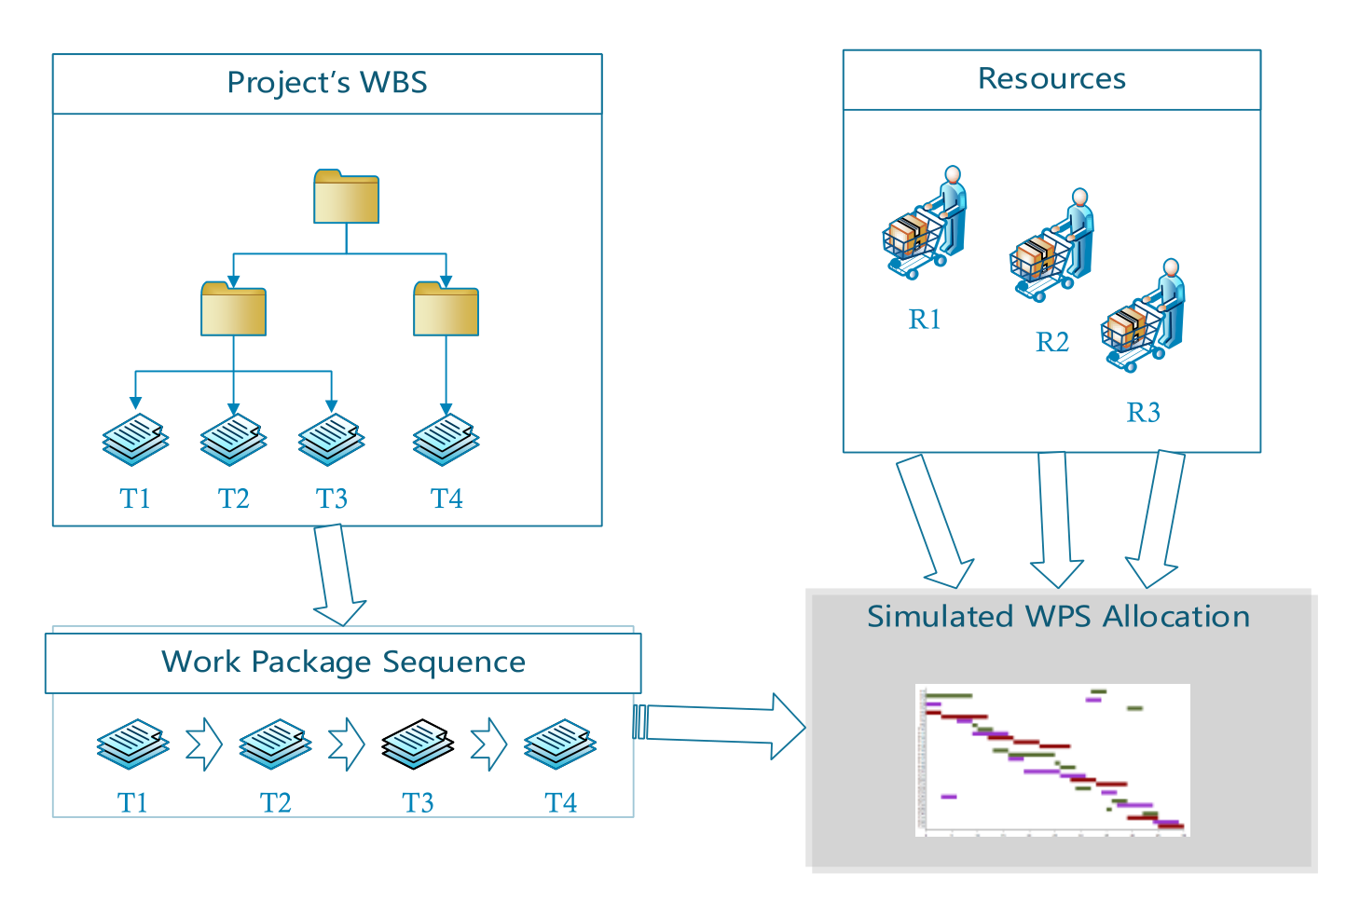
How we model the problem

Slide 8
Outline
Background & Problem Definition
Evolutionary Algorithm
Parallelism using GPGPU
Research Questions & Results
Tool & Future Work

Slide 9

The Representation of Solution
The solution represents the work package sequence
The work packages are sorted by their priorities as shown above.
Size of the solution space:
The total number of all possible solutions for a project containing $N$ work packages is $N!$

Slide 10
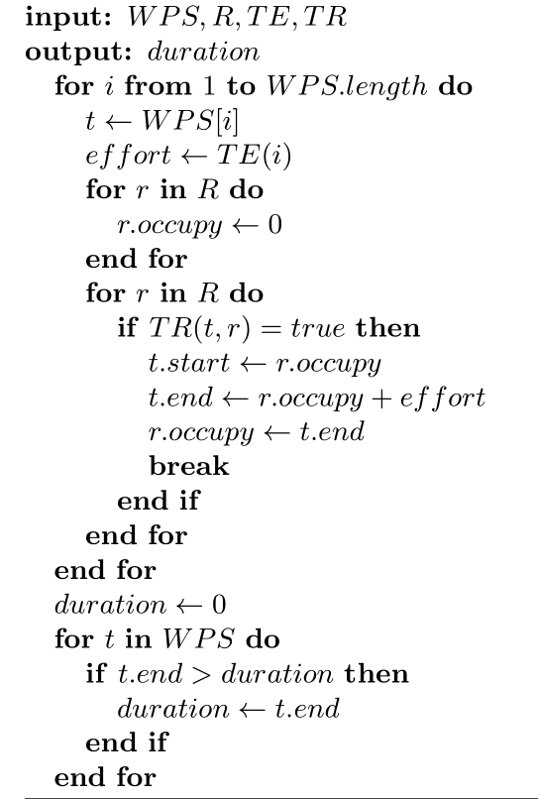
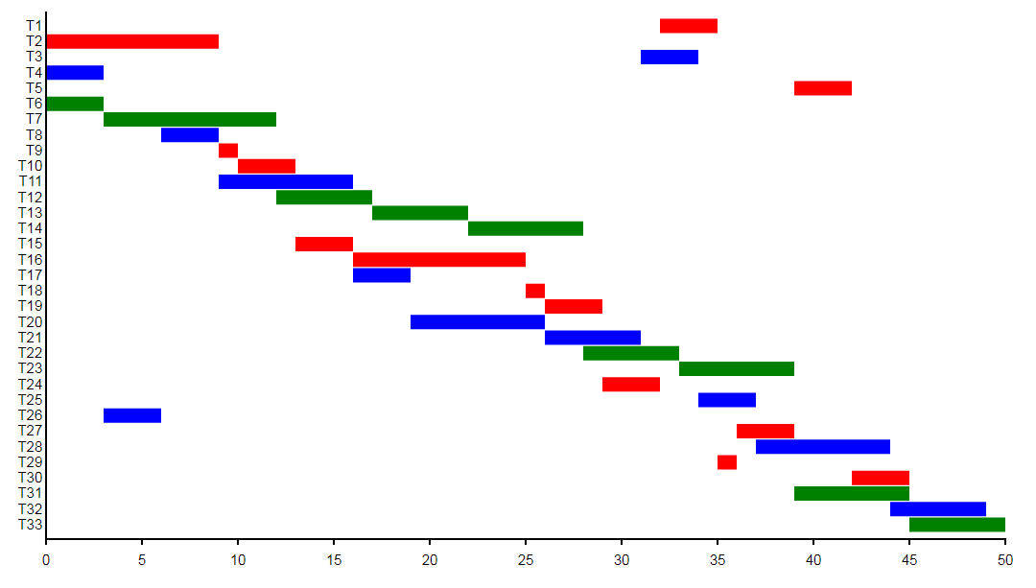
Fitness Evaluation
The same color shares the same resource.
Total 33 work packages with 50 days overall duration
http://jeanhwea.github.io/apps/gantt/index.html

Slide 11
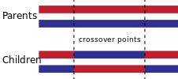
Genetic Operators for GA
Crossover: Two-point crossover
Mutation: Two-point exchange mutation
Randomly select two work packages in parents,
and exchange the two points to get children.

Slide 12
Outline
Background & Problem Definition
Evolutionary Algorithm
Parallelism using GPGPU
Research Questions & Results
Tool & Future Work

Slide 13

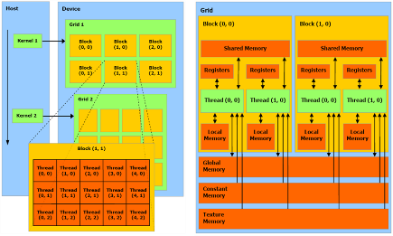


Why Parallelization???
Genetic Algorithm is computational expensive,
Mangers just don’t like to wait hours for an optimized solution.
However, due to the nature of GA, the fitness evaluation of each individual solution is independent from all other solutions in term of data and computation.
GPU has more cores than CPU!!!

Slide 14
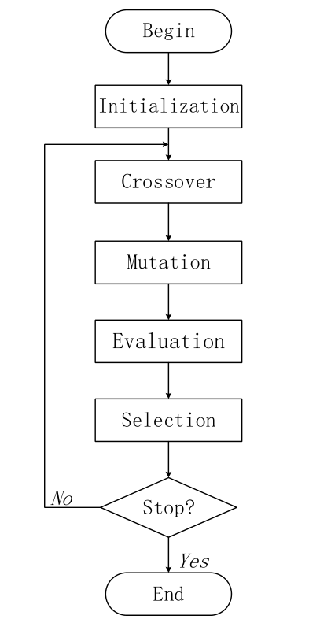
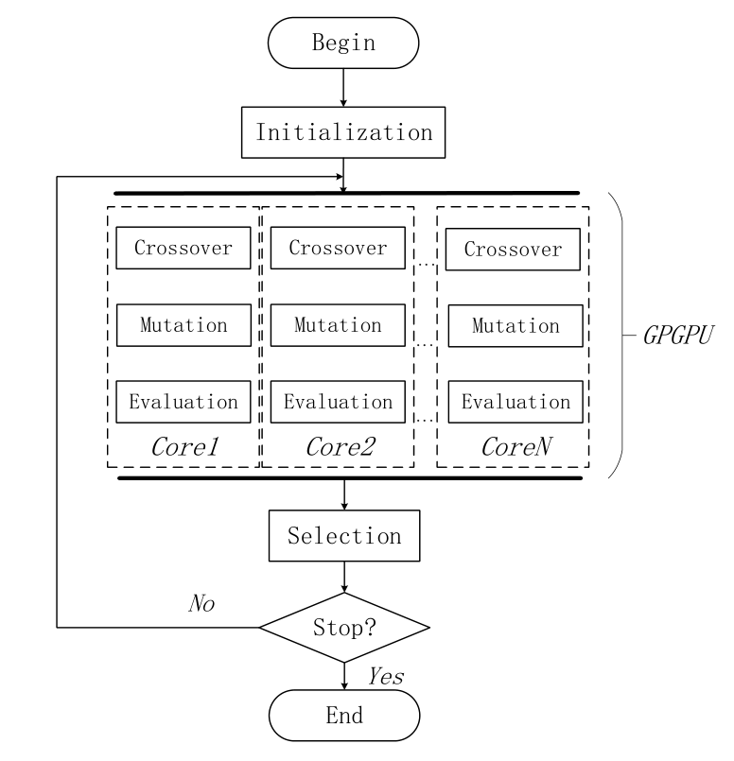
Our Implementation of Parallel Algorithm
sequential
parallel

Slide 15
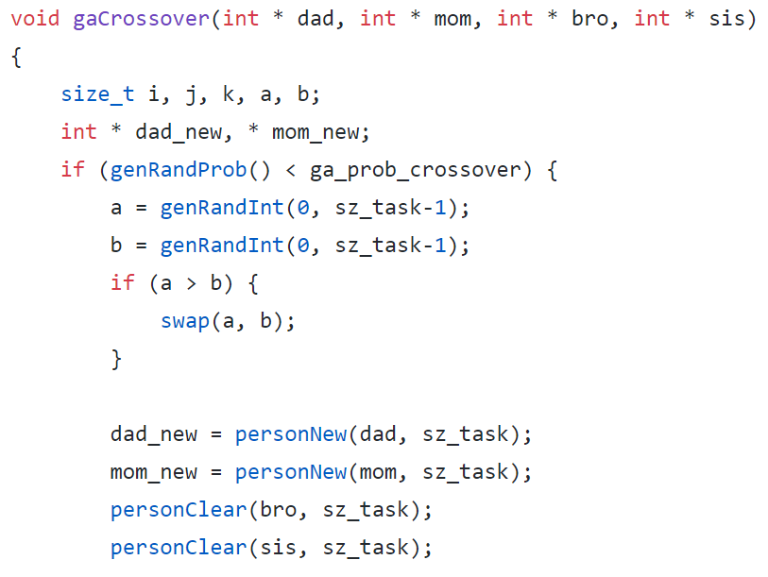
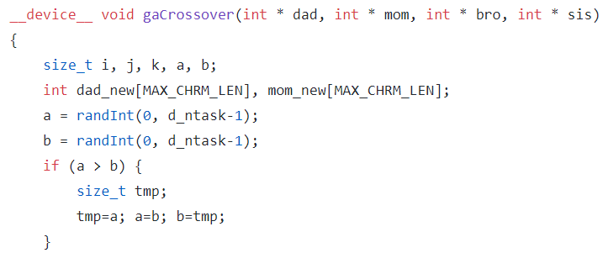
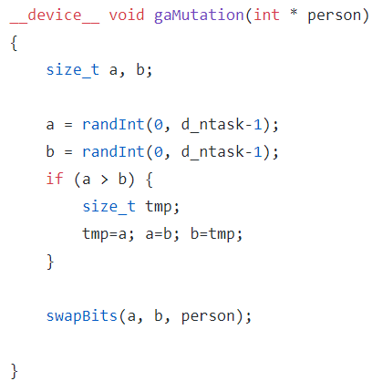
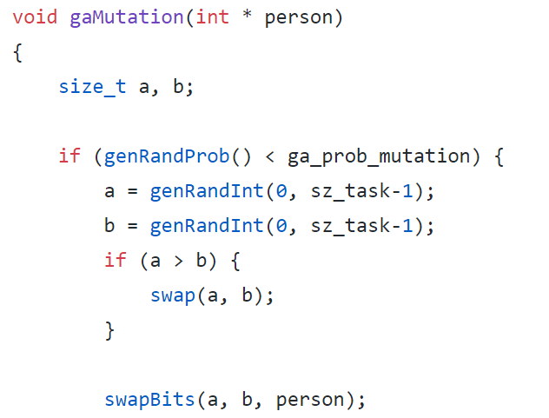
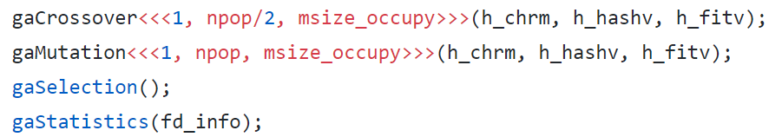
Sequential v.s. Parallel
npop: population size
Put computation into GPU core

Slide 16
Outline
Background & Problem Definition
Evolutionary Algorithm
Parallelism using GPGPU
Research Questions & Results
Tool & Future Work

Slide 17
Research Questions
RQ1(effectiveness) : Does the evolutionary algorithm effectively optimize project management problem, and get an optimized solution?
RQ2(efficiency) : Is the parallel evolutionary algorithm able to improve the efficiency in the project management problem?

Slide 18
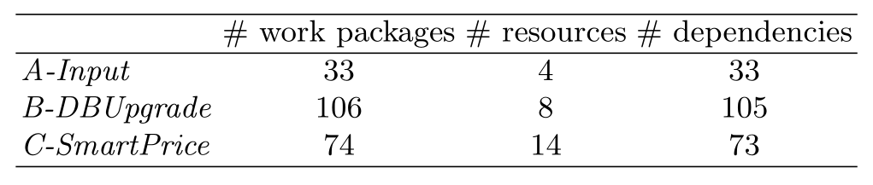
Industrial Project Data
A-Input: s simulated small-scale project planning.
B-DBUpgrade: upgrade the Oracle database from the 9g version to the 10g version
C-SmartPrice: a supply chain enhancement of medium size affecting mostly the website as well as a few internal applications

Slide 19
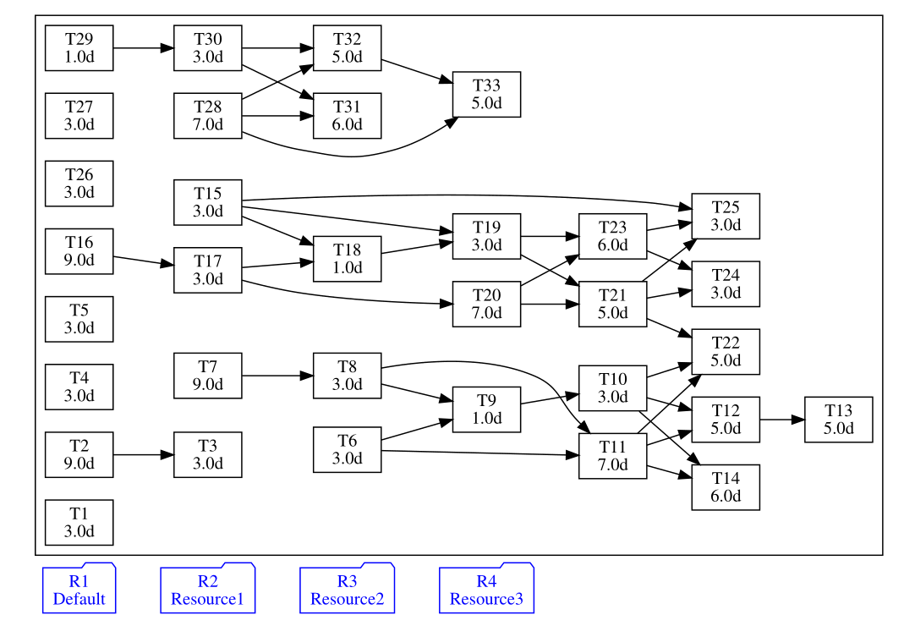
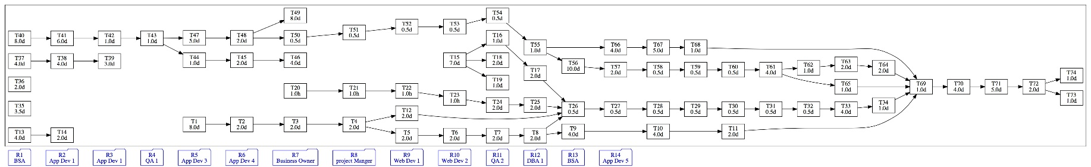
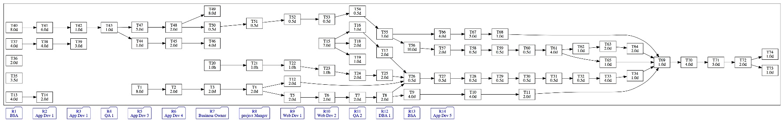
Work Package Dependencies
DAG (Directed Acyclic Graph)
Black Box -> Work Package
Blue Box -> Resource
Arrows -> Dependency

Slide 20
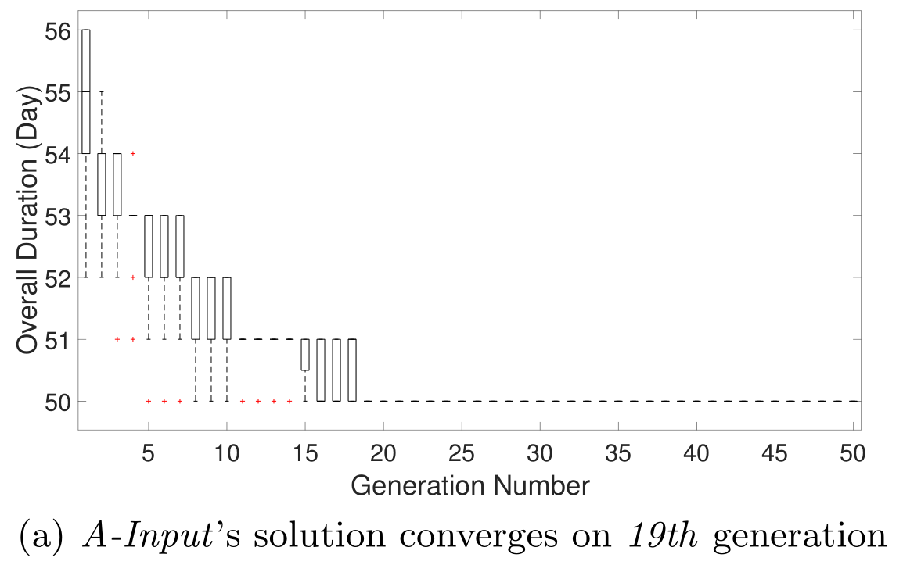
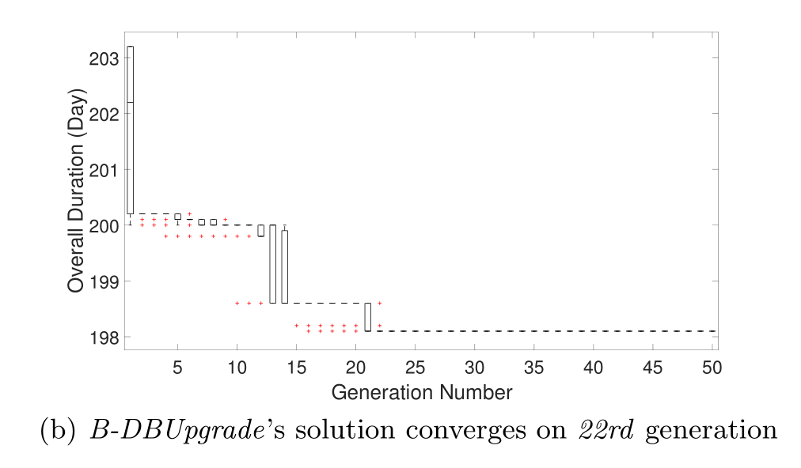
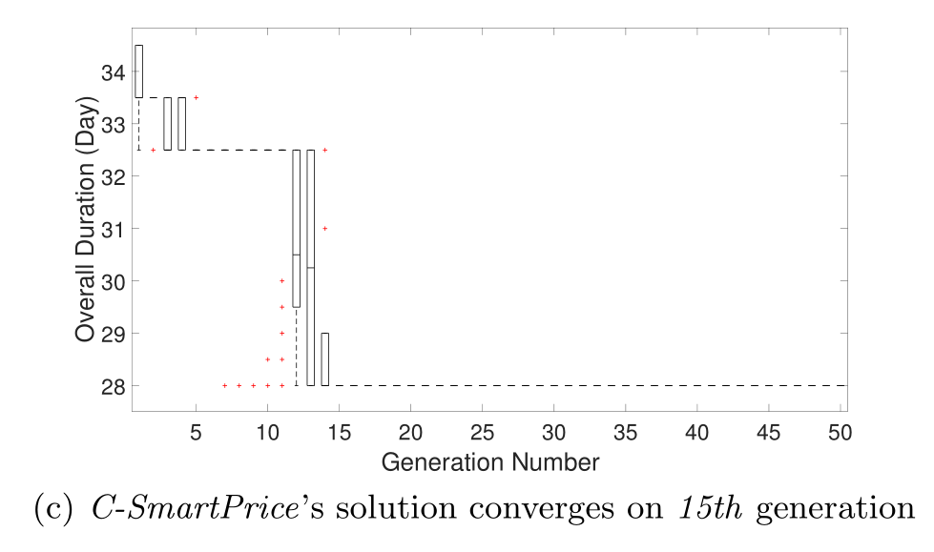
Result for RQ1: Effectiveness
The solutions converge in optimization progress

Slide 21
Runtime environment of CPU & GPU
CPU | GPU
Intel i7 series | Nvidia GeForce GTX 970
2.93GHz | 1.27GHz
8 cores | 1664 cores
Visual Studio C++ 2012 | CUDA 7.0.28

Slide 22
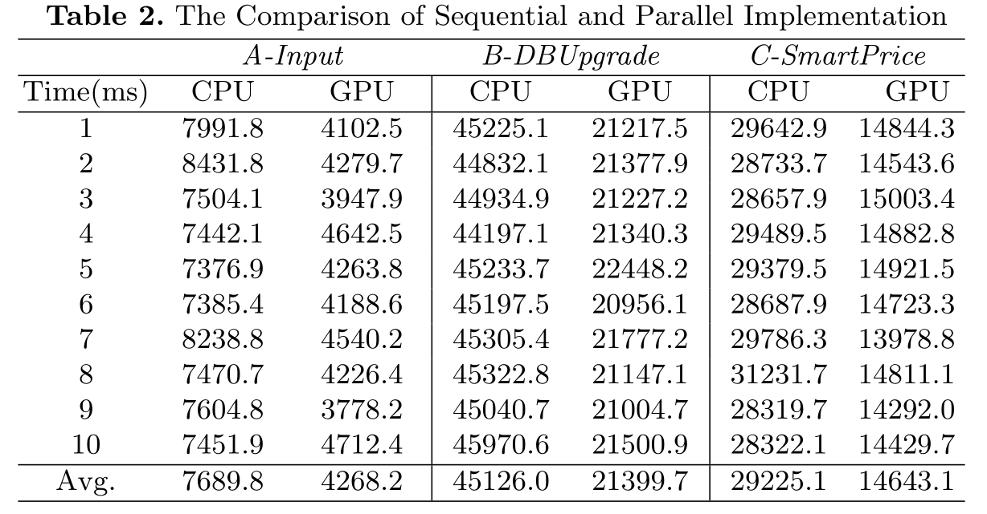
Result for RQ2: Acceleration
From the table, the executing time of sequential algorithm on CPU is roughly twice as long as the parallel algorithm on GPU

Slide 23
Outline
Background & Problem Definition
Evolutionary Algorithm
Parallelism using GPGPU
Research Questions & Results
Tool & Future Work

Slide 24
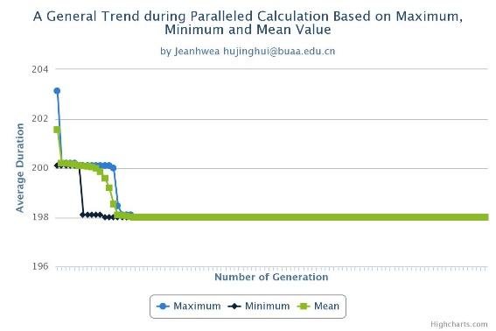
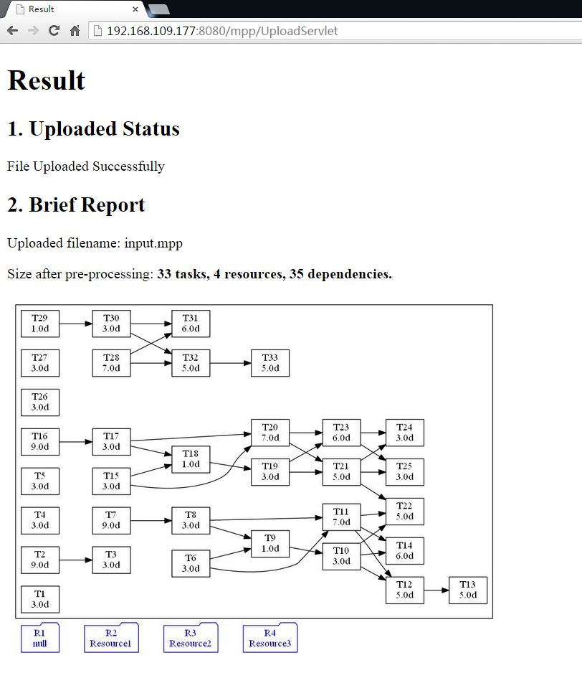
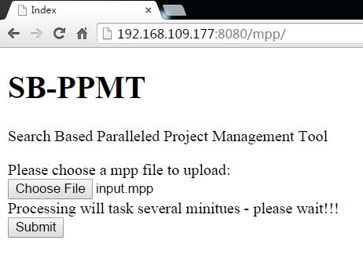
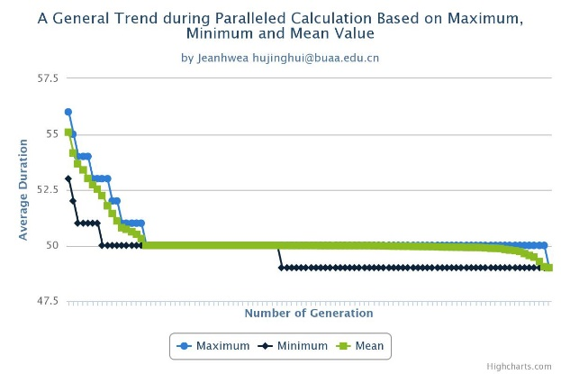
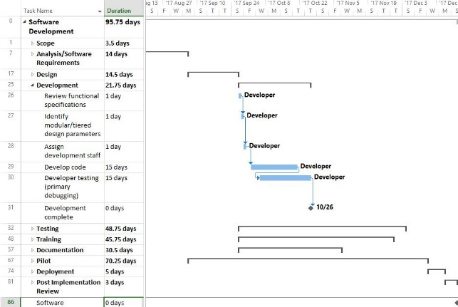
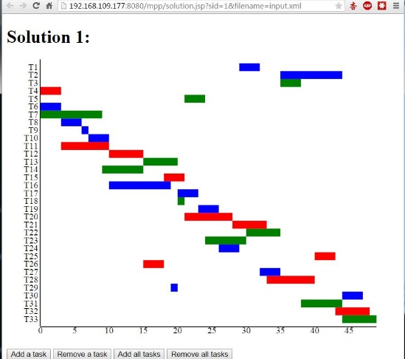
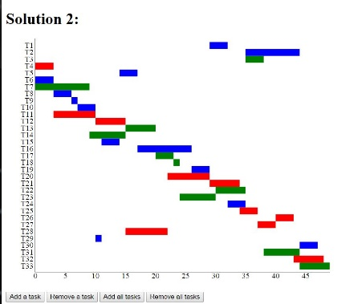
Tool Demo

Slide 25

Future Work
more sophisticated problem model
Staff absence, team construction, etc.
Advanced optimization techniques
Multiple objective, coevolution, etc.
Automated decision support

Slide 26
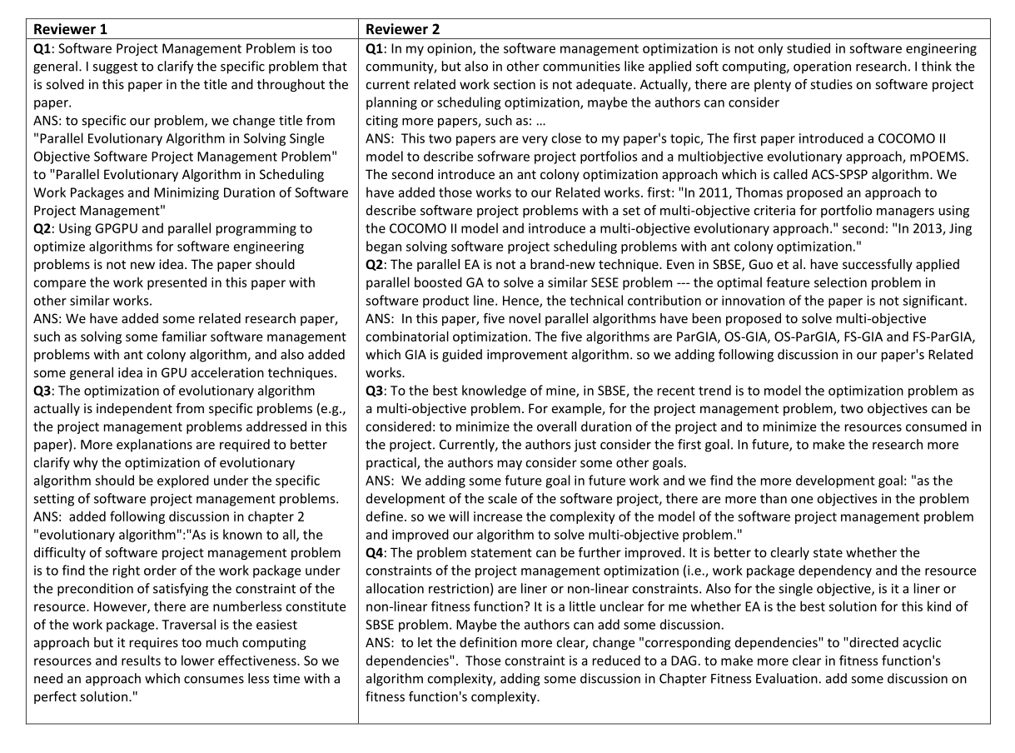
Reviewer’s comments

Slide 27
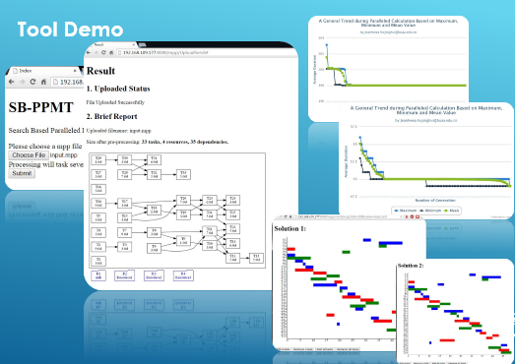
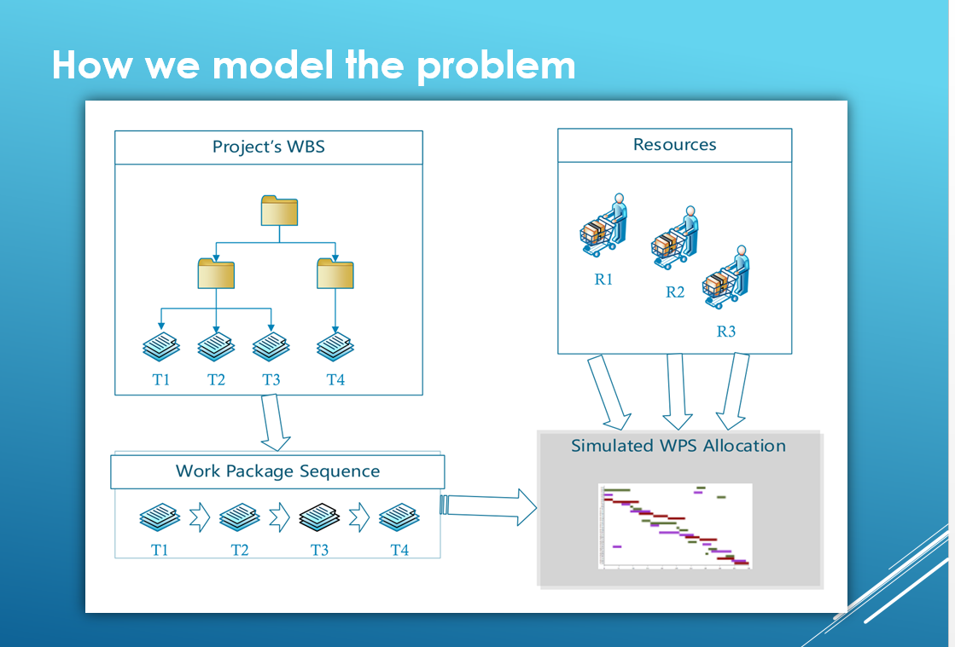
Jinghui Hu, Xu Wang, Jian Ren, Chao Liu, Beihang University
{hujinghui, bhwangxu, renjian, liuchao}@buaa.edu.cn

